Slide 1
C Programming

Slide 2
What is C?
C is a programming language developed at AT & T’s Bell Laboratories of USA in 1972.
It was designed and written by a man named Dennis Ritchie.
In the late seventies C began to replace the more familiar languages of that time like PL/I, ALGOL, etc.

Slide 3
What is C?
No one pushed C. It wasn’t made the ‘official’ Bell Labs language. Thus, without any advertisement C’s reputation spread and its pool of users grew.
Ritchie seems to have been rather surprised that so many programmers preferred C to older languages like FORTRAN or PL/I, or the newer ones like Pascal and APL. But, that's what happened.

Slide 4
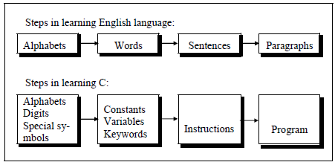
Getting Started with C

Slide 5
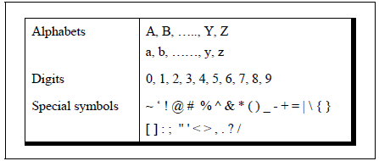
The C Character Set
A character denotes any alphabet, digit or special symbol used to represent information.

Slide 6
Constants, Variables and Keywords
The alphabets, numbers and special symbols when properly combined form constants, variables and keywords.

Slide 7
C Constants
A constant is an entity that doesn’t change whereas a variable is an entity that may change.

Slide 8
C Variables
An entity that may vary during program execution is called a variable.
Variable names are names given to locations in memory.
Since the value stored in each location may change the names given to these locations are called variable names.

Slide 9
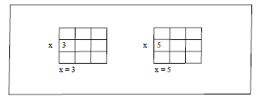
Variables
Here 3 is stored in a memory location and a name x is given to it.
Then we are assigning a new value 5 to the same memory location x.
This would overwrite the earlier value 3, since a memory location can hold only one value at a time.

Slide 10
Types of C Constants
C constants can be divided into two major categories:
Primary Constants
Secondary Constants

Slide 11
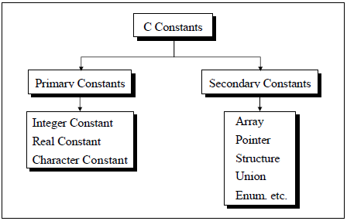
Types of C Constants

Slide 12
Rules for Constructing Integer Constants
An integer constant must have at least one digit.
It must not have a decimal point.
It can be either positive or negative.
If no sign precedes an integer constant it is assumed to be
positive.
No commas or blanks are allowed within an integer constant.
The allowable range for integer constants is -32768 to 32767.

Slide 13
Rules for Constructing Integer Constants
Ex.:
426
+782
-8000
-7605

Slide 14
Rules for Constructing Real Constants
Real constants are often called Floating Point constants.
The real constants could be written in two forms—
Fractional form and
Exponential form.

Slide 15
Rules for Fractional Form
Following rules must be observed while constructing real constants expressed in fractional form:
A real constant must have at least one digit.
It must have a decimal point.
It could be either positive or negative.
Default sign is positive.
No commas or blanks are allowed within a real constant.

Slide 16
Rules for Fractional Form
Ex.:
+325.34
426.0
-32.76
-48.5792

Slide 17
Rules for exponential Form
The mantissa part and the exponential part should be separated by a letter e.
The mantissa part may have a positive or negative sign. Default sign of mantissa part is positive.
The exponent must have at least one digit, which must be a positive or negative integer. Default sign is positive.
Range of real constants expressed in exponential form is -3.4e38 to 3.4e38.

Slide 18
Rules for exponential Form
Ex.:
+3.2e-5=3.2 x 10⁻⁵ = 0.000032
4.1e8=4.1 x 10⁸
-0.2e+3
-3.2e-5

Slide 19
Rules for Constructing Character Constants
A character constant is a single alphabet, a single digit or a single special symbol enclosed within single inverted commas.
Both the inverted commas should point to the left.
For example, ’A’ is a valid character constant whereas ‘A’ is not.
The maximum length of a character constant can be 1 character.

Slide 20
Rules for Constructing Character Constants
Ex.:
'A'
'I'
'5'
'='

Slide 21
Rules for Constructing Variable Names
A variable name is any combination of 1 to 31 alphabets,
digits or underscores.
The first character in the variable name must be an alphabet or underscore.
No commas or blanks are allowed within a variable name.
No special symbol other than an underscore (as in gross_sal) can be used in a variable name.

Slide 22
Rules for Constructing Variable Names
Ex.:
si_int
m_hra
pop_e_89

Slide 23
Rules for Constructing Variable Names
Which of the following are invalid variable names and why?
BASICSALARY
_basic
basic-hra
#MEAN
group.
422
population in 2006
over time

Slide 24
Rules for Constructing Variable Names
Which of the following are invalid variable names and why?
mindovermatter
FLOAT
hELLO
queue.
team’svictory
Plot # 3
2015_DDay

Slide 25
C Keywords
Keywords are the words whose meaning has already been explained to the C compiler
The keywords cannot be used as variable names
If we do so we are trying to assign a new meaning to the keyword, which is not allowed by the computer.
The keywords are also called ‘Reserved words’.
There are only 32 keywords available in C.

Slide 26
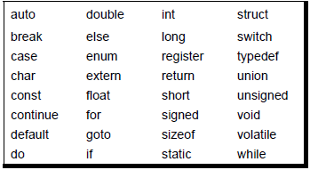
C Keywords

Slide 27
C Program 1
/* Calculation of simple interest */
/* Author gekay Date: 25/05/20018 */
main( )
{
int p, n ;
float r, si ;
p = 1000 ;
n = 3 ;
r = 8.5 ;
/* formula for simple interest */
si = p * n * r / 100 ;
printf ( "%f" , si ) ;
}

Slide 28
Comments
Comment about the program should be enclosed within /* */.
For example, the first two statements in our program are comments.

Slide 29
Comments
Though comments are not necessary, it is a good practice to begin a program with a comment indicating the purpose of the program, its author and the date on which the program was written.

Slide 30
Comments
Any number of comments can be written at any place in the program.
/* formula */ si = p * n * r / 100 ;
si = p * n * r / 100 ; /* formula */
si = p * n * r / /* formula */ 100 ;

Slide 31
Comments
Sometimes it is not so obvious as to what a particular statement in a program accomplishes.
At such times it is worthwhile mentioning the purpose of the statement (or a set of statements) using a comment.
For example:
/* formula for simple interest */
si = p * n * r / 100 ;

Slide 32
Comments
Often programmers seem to ignore writing of comments.
But when a team is building big software well commented code is almost essential for other team members to understand it.

Slide 33
main()
main( ) is a collective name given to a set of statements.
This name has to be main( ), it cannot be anything else.
Technically speaking main( ) is a function.
Every function has a pair of parentheses ( ) associated with it.

Slide 34
main()
All statements that belong to main( ) are enclosed within a pair of braces { }.
main( )
{
statement 1 ;
statement 2 ;
statement 3 ;
}

Slide 35
Variable Declaration
Any variable used in the program must be declared before using it.
For example,
int p, n ;
float r, si ;

Slide 36
The Semicolon ;
Any C statement always ends with a ;
For example,
float r, si ;
r = 8.5 ;

Slide 37
The Operators
In the statement,
si = p * n * r / 100 ;
* and / are the arithmetic operators.
The arithmetic operators available in C are +, -, * and /. C is very rich in operators.
There are about 45 operators available in C.

Slide 38
printf()
All output to screen is achieved using readymade library functions.
One such function is printf( ).
We have used it display on the screen the value contained in si.

Slide 39
printf()
The general form of printf( ) function is,
printf ( "<format string>", <list of variables> ) ;
<format string> can contain,
%f for printing real values
%d for printing integer values
%c for printing character values

Slide 40
printf()
Eg-
printf ( "%f", si ) ;
printf ( "%d %d %f %f", p, n, r, si ) ;
printf ( "Simple interest = Rs. %f", si ) ;
printf ( "Prin = %d \nRate = %f", p, r ) ;

Slide 41
printf()
printf ( "Prin = %d \nRate = %f", p, r ) ;
The output of the last statement would look like this...
Prin = 1000
Rate = 8.5

Slide 42
printf()
What is ‘\n’ doing in this statement?
It is called newline and it takes the cursor to the next line.
Therefore, you get the output split over two lines. ‘\n’ is one of the several Escape Sequences available in C.

Slide 43
printf()
printf( ) can not only print values of variables,
It can also print the result of an expression.
An expression is nothing but a valid combination of constants, variables and operators.
Thus, 3, 3 + 2, c and a + b * c – d all are valid expressions.

Slide 44
printf()
Eg-
printf ( "%d %d %d %d", 3, 3 + 2, c, a + b * c – d ) ;
Note that 3 and c also represent valid expressions.

Slide 45
scanf()
To make the program general the program itself should ask the user to supply the values of p, n and r through the keyboard during execution.
This can be achieved using a function called scanf( ).
This function is a counter-part of the printf( ) function.
printf( ) outputs the values to the screen whereas scanf( ) receives them from the keyboard.

Slide 46
C Program 2
/* Calculation of simple interest */
/* Author gekay Date 25/05/2004 */
main( )
{
int p, n ;
float r, si ;
printf ( "Enter values of p, n, r" ) ;
scanf ( "%d %d %f", &p, &n, &r ) ;
si = p * n * r / 100 ;
printf ( "%f" , si ) ;
}

Slide 47
ampersand (&)
Note that the ampersand (&) before the variables in the scanf( ) function is a must.
& is an ‘Address of’ operator.
It gives the location number used by the variable in memory.
When we say &a, we are telling scanf( ) at which memory location should it store the value supplied by the user from the keyboard

Slide 48
scanf( )
A blank, a tab or a new line must separate the values supplied to scanf( ).
A blank is creating using a spacebar, tab using the Tab key and new line using the Enter key.

Slide 49
scanf( )
Ex.:
The three values separated by blank
1000 5 15.5
Ex.:
The three values separated by tab.
1000 5 15.5
Ex.:
The three values separated by newline.
1000
5
15.5

Slide 50
Program 3- C Program to find the area of a circle

Slide 51
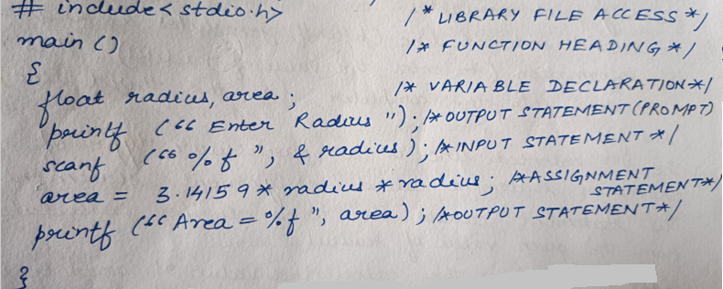
Program 3- C Program to find the area of a circle

Slide 52
Compilation
Assuming that you are using a Turbo C or Turbo C++ compiler
Steps to compile and execute your first C program…
Start the compiler at C> prompt.
The compiler TC.EXE is usually present in C:\TC\BIN directory.
Select New from the File menu.
Type the program.
Save the program using F2 under a proper name (say Program1.c).
Use Ctrl + F9 to compile and execute the program.
Use Alt + F5 to view the output.

Slide 53
Program 4- C Program to convert temperature from degree celsius to fahrenheit Deg F=(Deg C*9)/5+32

Slide 54
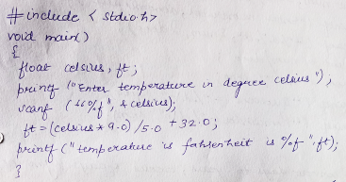
Program 4- C Program to convert temperature from degree celsius to fahrenheit Deg F=(Deg C*9)/5+32

Slide 55
Program 5- C Program to calculate the area of an equilateral triangle where side is entered by the user

Slide 56
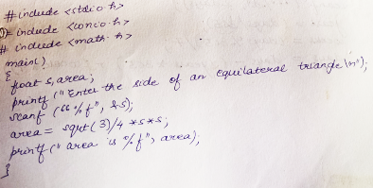
Program 5- C Program to calculate the area of an equilateral triangle where side is entered by the user

Slide 57
TUT2

Slide 58
Write a C Program to Compute Quotient and Remainder

Slide 59
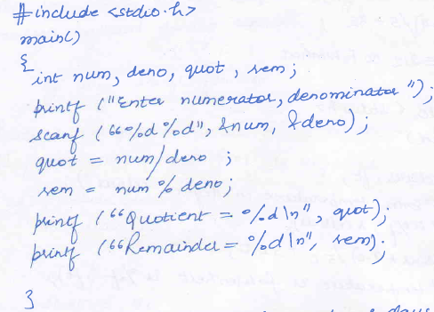
Write a C Program to Compute Quotient and Remainder

Slide 60
Write a C Program to Convert days to years, weeks & days ignoring leap year

Slide 61
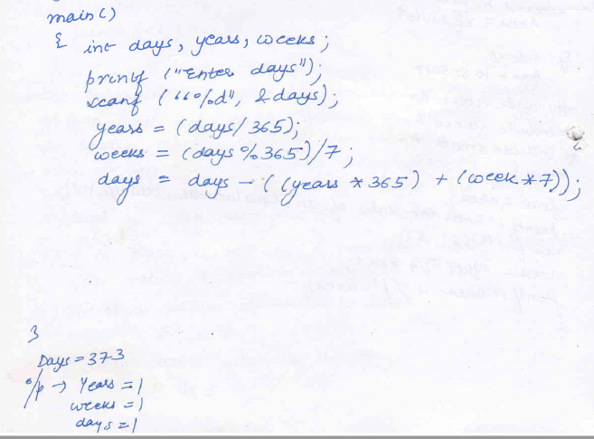
Write a C Program to Convert days to years, weeks & days ignoring leap year
printf(“Years=%d\n”,years);
printf(“Weeks=%d\n”,weeks);
printf(“Days=%d\n”,days);

Slide 62
Escape Sequences

Slide 63
Escape Sequences
We saw earlier how the newline character,
\n, when inserted in a printf( )’s format string, takes the cursor to the beginning of the next line.

Slide 64
Escape Sequences
Escape sequences that begin with a \ sign
The newline character \n is an ‘escape sequence’,

Slide 65
Escape Sequences
The backslash symbol (\) is considered as an ‘escape’ character—
it causes an escape from the normal interpretation of a string,
so that the next character is recognized as one having a special meaning.

Slide 66
Escape Sequences
\t-Horizontal Tab
A \t moves the cursor to the next tab stop.
A 80-column screen usually has 10 tab stops.
The screen is divided into 10 zones of 8 columns each.
Printing a tab takes the cursor to the beginning of next printing zone.
For example, if cursor is positioned in column 5, then printing a tab takes it to column 8.

Slide 67
Program
main( )
{
printf ( "You\tmust\tbe\tcrazy\nto\thate\tthis\tbook" ) ;
}

Slide 68
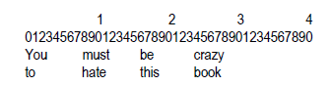
Output-
main( )
{
printf ( "You\tmust\tbe\tcrazy\nto\thate\tthis\tbook" ) ;
}
Output-

Slide 69
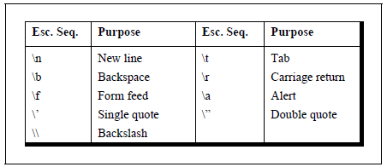
Escape Sequences
\b moves the cursor one position to the left of its current position.
\r takes the cursor to the beginning of the line in which it is currently placed.

Slide 70
Escape Sequences
\a alerts the user by sounding the speaker inside the computer.
\f Form feed advances the computer stationery attached to the printer to the top of the next page.

Slide 71
Escape Sequences
Characters that are ordinarily used as delimiters...
the single quote
double quote
the backslash
can be printed by preceding them with the backslash.

Slide 72
\v- Vertical Tab
// C program to illustrate \v escape sequence
#include <stdio.h>
int main(void)
{
// Here we are using \v, which is vertical tab character.
printf("Hello\v friends\v");
printf("Welcome\v to GFG");
return (0);
}

Slide 73
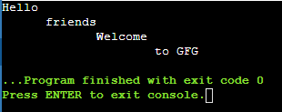
Output-

Slide 74
\b
// C program to illustrate \b escape sequence
#include <stdio.h>
int main(void)
{
// \b - backspace character transfers
// the cursor one character back with
// or without deleting on different
// compilers.
printf("Hello Geeks\b\b\b\bF");
return (0);
}

Slide 75
\n
// C program to illustrate \' escape
// sequence/ and \" escape sequence to
// print single quote and double quote.
#include <stdio.h>
int main(void)
{
printf("\' Hello Geeks\n");
printf("\" Hello Geeks");
return 0;
}

Slide 76
Output-
' Hello Geeks
" Hello Geeks

Slide 77
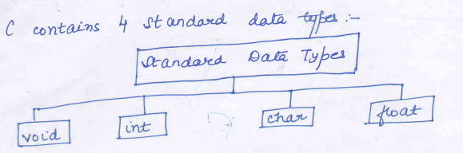
Data Types

Slide 78
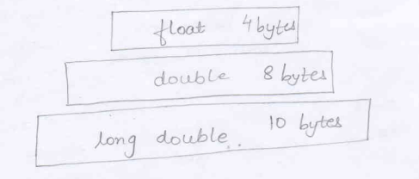
Float

Slide 79
Float
A floating point number is a number with a fractional part
A float occupies four bytes in memory
Can range from -3.4e38to +3.4e38.
If this is insufficient then C offers a double data type

Slide 80
Doubles
A double data type occupies 8 bytes in memory
Has a range from -1.7e308 to +1.7e308.
A variable of type double can be declared as,
double a, population ;

Slide 81
Long Double
If the situation demands usage of real numbers that lie even beyond the range offered by double data type,
There exists a long double
Can range from -1.7e4932 to +1.7e4932.
A long double occupies 10 bytes in memory.

Slide 82
Float,Double,Long Double
Float=6 decimal places
Double=15 decimal places
Long Double=19 decimal places

Slide 83

Float,Double,Long Double

Slide 84
Short, long int
C offers a variation of the integer data type
Provides what are called short and long integer values.
The intention of providing these variations is to provide integers with different ranges wherever possible.

Slide 85
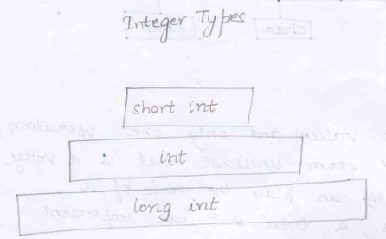
Short, int, long int

Slide 86
Short, long int
Though not a rule, short and long integers would usually occupy two and four bytes respectively.

Slide 87
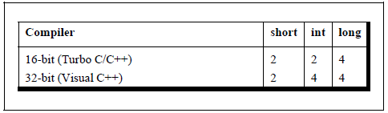
Short, long int
Each compiler can decide appropriate sizes depending on the operating system and hardware for which it is being written, subject to the following rules:
shorts are at least 2 bytes big
longs are at least 4 bytes big
shorts are never bigger than ints
ints are never bigger than longs

Slide 88
long int
long variables which hold long integers are declared using the keyword long, as in,
long int i ;
long int abc ;

Slide 89
long int
long integers cause the program to run a bit slower,
But the range of values that we can use is expanded tremendously.
The value of a long integer typically can vary from -2147483648 to +2147483647.
More than this you should not need unless you are taking a world census.

Slide 90
short int
Symmetry requires shorts as well—
Integers that need less space in memory and thus help speed up program execution.
short integer variables are declared as,
short int j ;
short int height ;

Slide 91
short and long int
C allows the abbreviation of short int to short and of long int to long.
So the declarations made above can be written as,
long i ;
long abc ;
short j ;
short height ;

Slide 92
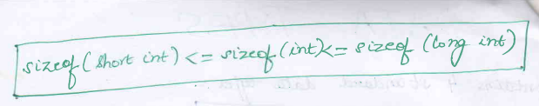
Short,int,long

Slide 93
Integers, signed and unsigned
Sometimes, we know in advance that the value stored in a given integer variable will always be positive—
When it is being used to only count things,
For example. In such a case we can declare the variable to be unsigned, as in,
unsigned int num_students ;

Slide 94
Integers, signed and unsigned
With such a declaration, the range of permissible integer values (for a 16-bit OS) will shift from the range -32768 to +32767 to the range 0 to 65535.
Thus, declaring an integer as unsigned almost doubles the size of the largest possible value that it can otherwise take.

Slide 95
Integers, signed and unsigned
This so happens because on declaring the integer as unsigned,
the left-most bit is now free and is not used to store the sign of the number.
Note that an unsigned integer still occupies two bytes.

Slide 96
Integers, signed and unsigned
This is how an unsigned integer can be declared:
unsigned int i ;
unsigned i ;

Slide 97
Chars, signed and unsigned
Parallel to signed and unsigned ints (either short or long),
Similarly there also exist signed and unsigned chars,
Both occupying one byte each, but having different ranges.
To begin with it might appear strange as to how a char can have a sign.

Slide 98
Chars, signed and unsigned
Consider the statement
char ch = 'A' ;
Here what gets stored in ch is the binary equivalent of the ASCII value of ‘A’ (i.e. binary of 65).
And if 65’s binary can be stored, then -54’s binary can also be stored (in a signed char).

Slide 99
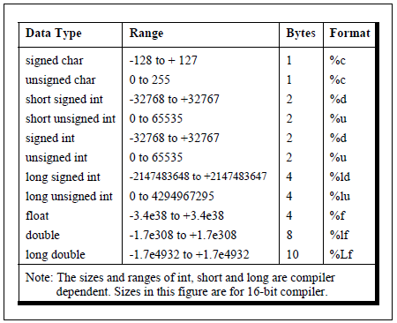
Summary of Data Types

Slide 100
main( )
{
char c ;
unsigned char d ;
int i ;
unsigned int j ;
short int k ;
unsigned short int l ;
long int m ;
unsigned long int n ;
float x ;
double y ;
long double z ;
/* char */
scanf ( "%c %c", &c, &d ) ;
printf ( "%c %c", c, d ) ;
/* int */
scanf ( "%d %u", &i, &j ) ;
printf ( "%d %u", i, j ) ;
/* short int */
scanf ( "%d %u", &k, &l ) ;
printf ( "%d %u", k, l ) ;
/* long int */
scanf ( "%ld %lu", &m, &n ) ;
printf ( "%ld %lu", m, n ) ;
/* float, double, long double */
scanf ( "%f %lf %Lf", &x, &y, &z ) ;
printf ( "%f %lf %Lf", x, y, z ) ;
}

Slide 101
Format Specifications
The %d and %f used in the printf( ) are called format specifiers.
They tell printf( ) to print the value of avg as a decimal integer

Slide 102
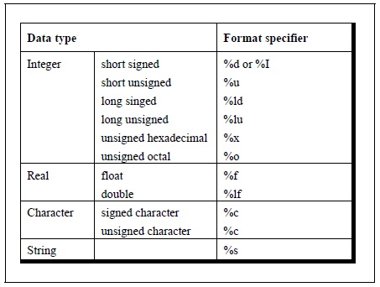
Format Specifications
Following is the list of format specifiers that can be used with the printf( ) function.

